Slide 1

AI JOURNAL WITH SENTIMENT ANALYSIS
SPRINT 2
17 April, 2026
Notes:
we still need to choose a logo and replace it with the one here

Slide 2
AGENDA OVERVIEW
01
06
TEAM MEMBER ROLES AND RESPONSIBILITIES
MVP
02
07
IMPROVEMENTS MADE FROM FEEDBACK
TECHNOLOGIES
03
08
PROJECT DESCRIPTION
ALGORITHMS
04
09
TEAM WORKING AGREEMENT
DIAGRAMS
05
10
USER PERSONAS
SPRINT 1 RECAP

Slide 3
AGENDA OVERVIEW CONTD.
11
16
PRODUCT BACKLOG
PROJECT DEMO
12
17
SPRINT 2 BACKLOG
OUR GITHUB
13
18
METRICS
LIVE APP DEMO
14
19
RETROSPECTIVE
WIKI PAGE
15
20
SPRINT 3 PLANNING
TEAM NEXUS

Slide 4






TEAM MEMBERS
KRISHNA
CHINTAN KOTADIYA
RAFAELA HOLLANDA
Scrum Master | Developer
Developer | Tester
Team Leader | Developer
VANESSA AGBUGBA
SANKET MATROJA
SAI
Front End Developer
AI Generalist
Developer
Notes:
Are we including Professor Wong like he asked? I did it in case, if not, we can take it out.
Also we need Sanket's and Sai's roles
We also need pictures

Slide 5
IMPROVEMENTS MADE FROM
PROFESSOR’S FEEDBACK
Feedback: Link on wikipage was not accurate
Action: Wikipage was updated with accurate links
Notes:
Used a random sad man's picture to depict mental health, lmk if it works! if not, we can change it.

Slide 6
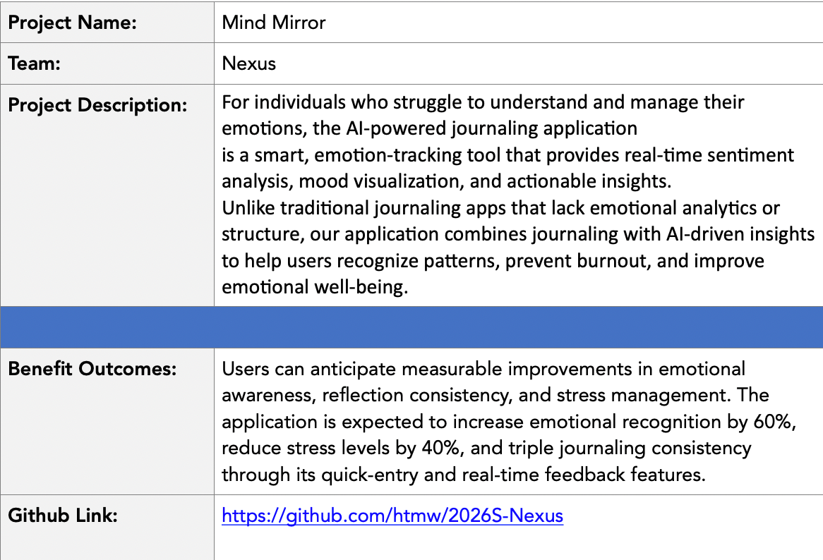

PROJECT DESCRIPTION
Team Nexus

Slide 7
COMMUNICATION PLAN
• Primary instant meeting platform: WhatsApp
• Video Meeting: Discord
Team members are expected to:
• Communicate respectfully and professionally
• Respond to messages within a reasonable time frame (ideally within 24 hours)
• Share progress updates, blockers, and concerns openly
• Use the agreed communication tools for all project-related discussions
TEAM WORKING AGREEMENT
MEETINGS & AVAILABILITY
The team will hold three regular sync meetings per week:
• Sunday: 10:00 AM • Tuesday: 6:30 PM • Thursday: 9:00 PM
Additional meetings may be scheduled as needed based on sprint requirements. Expectations:
• All members should attend scheduled meetings
• If unable to attend, members must notify the team in advance
• Meeting notes and action items will be documented and shared
Team Nexus

Slide 8
TASK MANAGEMENT
• Task tracking tool: Jira
All project tasks will be:
• Clearly defined and assigned
• Tracked through Jira
• Updated regularly to reflect progress
• Completed before agreed internal deadlines
TEAM WORKING AGREEMENT
CONFLICT RESOLUTION
In the event of conflict:
1. The concerned party should first express the issue to the team openly and respectfully
2. The team will attempt to resolve the issue collaboratively
3. If unresolved, the issue will be escalated to the Team Leader / Scrum Coordinator
4. Further escalation (e.g., to the instructor) will be considered only if necessary
Team Nexus

Slide 9
WORK EXPECTATIONS &
DEFINITION OF DONE
Each task is considered “Done” when:
• It meets the agreed acceptance criteria
• It is reviewed by at least one other team member (when applicable)
• Code runs without critical errors
• Relevant documentation is updated
• Changes are committed to the shared repository
Team members are responsible for:
• Completing assigned work on time
• Communicating blockers early
• Supporting teammates when needed
TEAM WORKING AGREEMENT
Team Nexus

Slide 10

NAME: SARAH MARTINEZ
STUDENT PERSONA
Age: 21
Gender: Female
Occupation: Undergraduate Computer Science Student
Sarah is a full-time college student balancing coursework, part-time work, and social commitments. During exam periods, her stress levels rise significantly, but she often ignores the early warning signs of burnout. She occasionally journals but finds long entries overwhelming and inconsistent. She wants a simple way to reflect daily without spending too much time.
Challenges:
Experiences fluctuating stress levels during the semester
Inconsistent journaling habits
Difficulty recognizing emotional patterns over time
Feels overwhelmed during midterms and finals
Goals:
Track emotional trends throughout the semester
Identify early signs of burnout
Receive short, actionable suggestions
Maintain better emotional balance during academic pressure

Slide 11

WORKING PROFESSIONAL PERSONA
NAME: DAVID CHEN
Age: 32
Gender: Male
Occupation: Software Engineer
David works remotely for a tech company and spends most of his day attending meetings and coding. While he performs well professionally, he often feels mentally drained without clearly understanding the cause. He values productivity and self-improvement but rarely pauses to reflect on his emotional state.
Challenges:
Blurred boundaries between work and personal life
Emotional fatigue during high-pressure deadlines
No structured way to monitor mood patterns
Limited time for long reflection exercises
Goals:
Understand how work stress affects his mood
Monitor emotional stability over time
Receive quick, data-driven insights
Improve work-life balance

Slide 12

WORKING PARENT PERSONA
NAME: EMILY PETERSON
Age: 40
Gender: Female
Occupation: HR Manager
Emiliy balances a demanding job with parenting responsibilities. Her schedule leaves little time for self-reflection, yet she recognizes the importance of emotional awareness. She often feels emotionally exhausted but cannot clearly identify triggers or patterns. She prefers simple, easy-to-use digital tools.
Challenges:
Limited time for lengthy journaling
Emotional fatigue from multitasking responsibilities
Difficulty identifying emotional triggers
Wants non-clinical, supportive guidance
Goals:
Build daily emotional awareness
Identify patterns in stress levels
Receive manageable well-being suggestions
Maintain emotional stability for herself and her family

Slide 13

SELF-IMPROVEMENT ENTHUSIAST PERSONA
NAME: ALEX RIVERA
Age: 27
Gender: Male
Occupation: Fitness Coach
Alex actively tracks his workouts, sleep cycles, and productivity habits. He believes emotional well-being is just as important as physical health but lacks a structured system to measure it. He is interested in data-driven insights and enjoys tools that provide analytics and visualizations.
Challenges:
Journaling apps provide no analytical insights
No measurable way to track emotional consistency
Wants deeper pattern recognition
Prefers technology-backed recommendations
Goals:
Quantify emotional trends
Compare mood ratings with AI sentiment analysis
Identify emotional volatility
Optimize overall mental performance

Slide 14
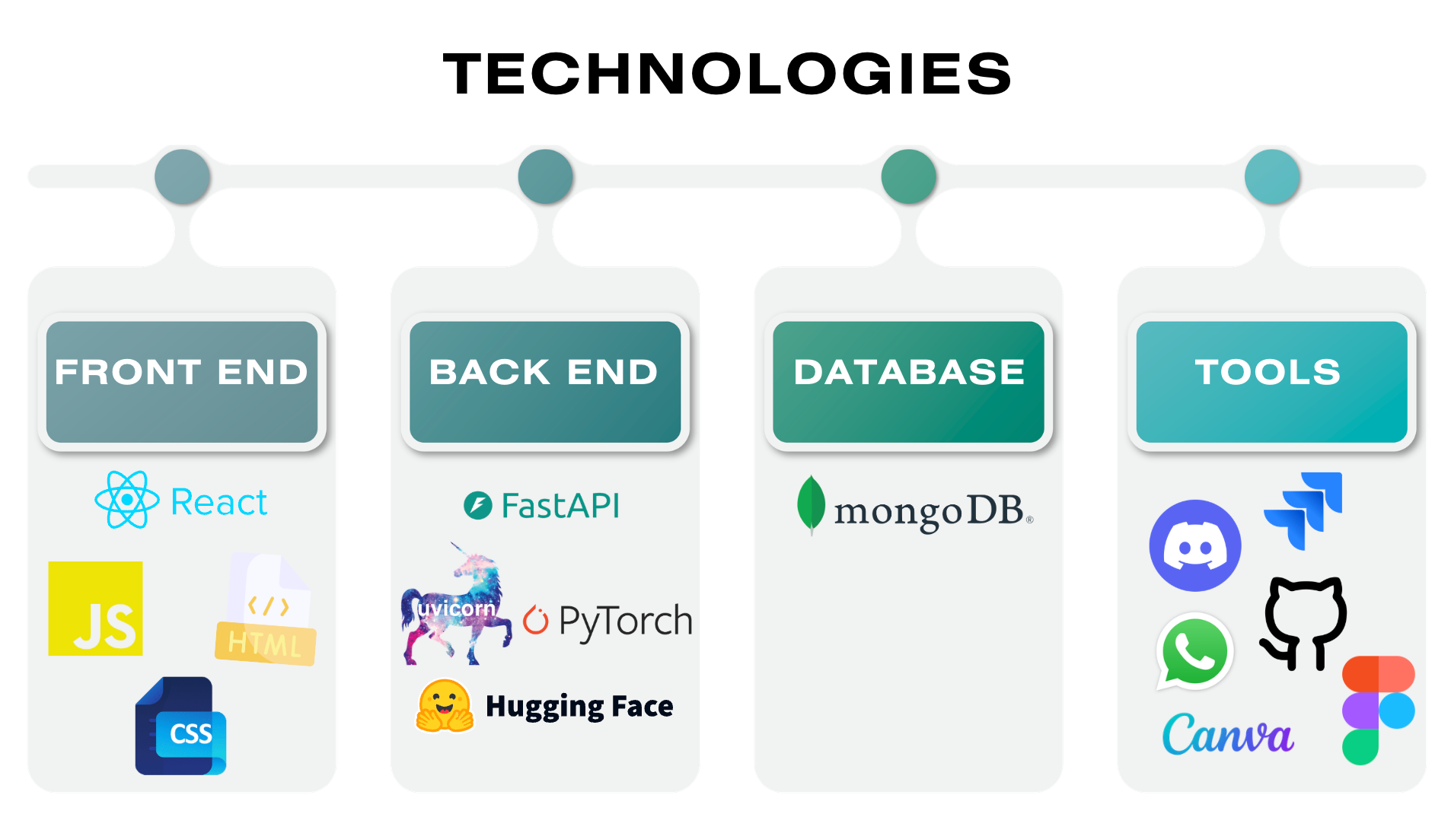

Slide 15
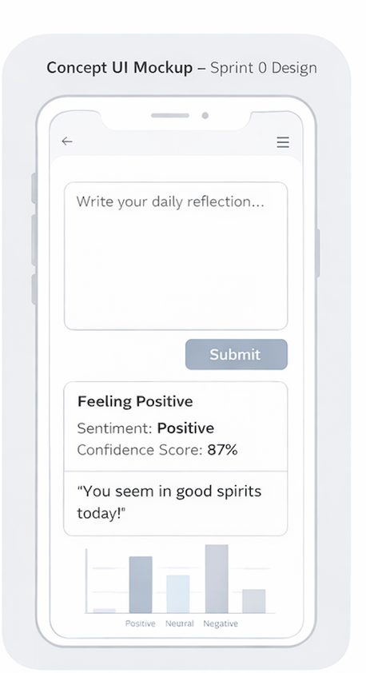
MINIMAL VIABLE PRODUCT (MVP)
An AI-powered journaling application with real-time emotional analysis and visual mood tracking.
Real-Time Sentiment Analysis – Journal entries are analyzed instantly using an NLP model.
Mood Classification System – Each entry is labeled as Positive, Neutral, or Negative.
Confidence Score Display – Shows the model’s certainty level for each classification.
Immediate Mood Feedback – Provides short, supportive emotional insights after analysis
Visual Mood Distribution – Displays a basic chart showing mood trends over time.
Local Entry Persistence – Saves journal entries locally for later review (MVP scope).
Team Nexus

Slide 16

COMPONENTS
● Journal Input Manager : Handles user journal entry input and submission through the web interface.
● Backend API Manager : Manages HTTP requests and communication between frontend, sentiment model, and database.
● Sentiment Analysis Manager : Processes journal text and classifies sentiment (Positive / Neutral / Negative).
● Confidence Scoring Module: Extracts prediction probability scores from the DistilBERT output.
● Mood Feedback Generator: Converts sentiment results into short, supportive emotional insights.
● Data Persistence Layer : Stores journal entries, sentiment labels, confidence scores, and timestamps.
● Mood Visualization Manager: Retrieves stored data and generates mood distribution charts over time.
Team Nexus

Slide 17
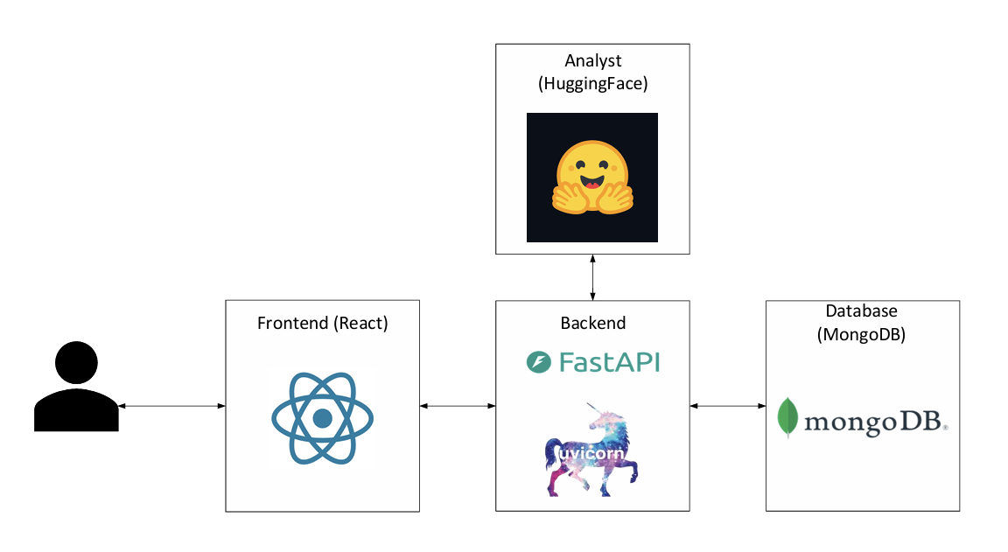
ARCHITECTURE
DIAGRAM
Team Nexus

Slide 18
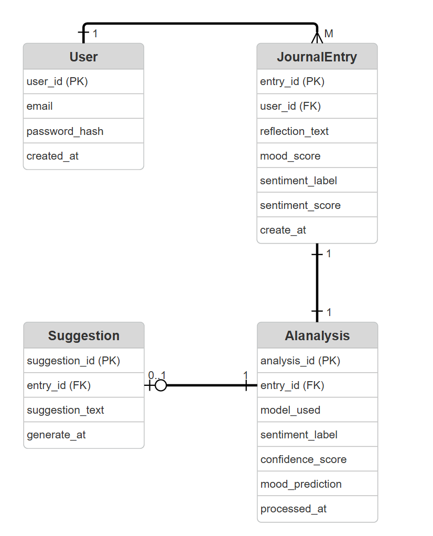
ER DIAGRAM
Team Nexus

Slide 19
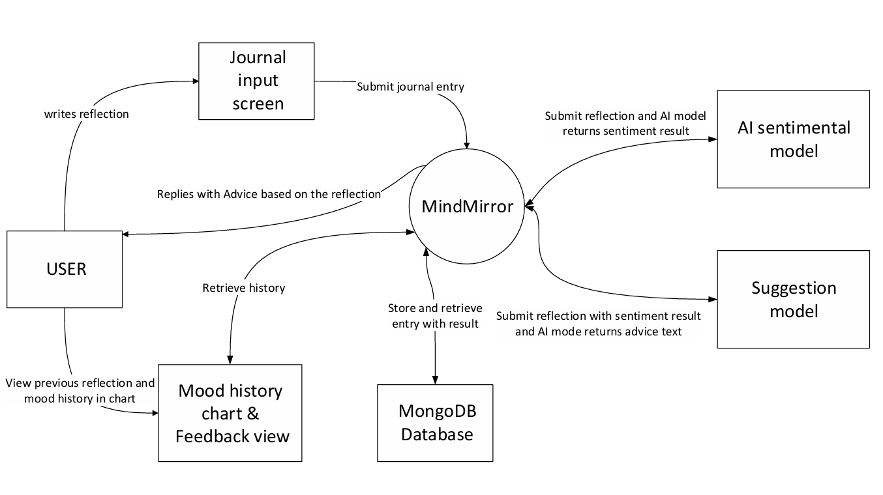
CONTEXT
DIAGRAM
Team Nexus

Slide 20
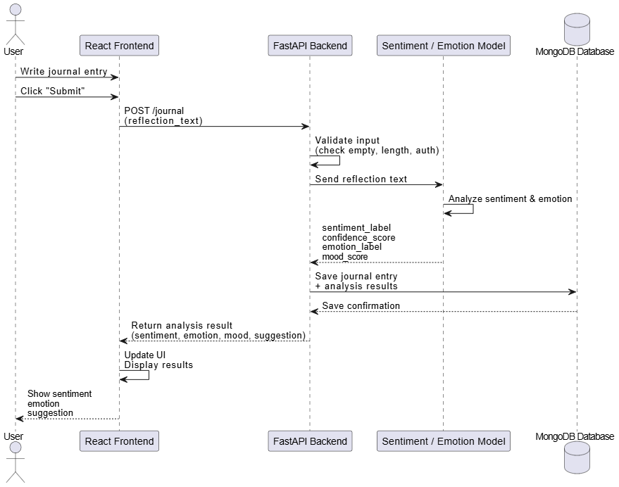
SEQUENCE DIAGRAM
-JOURNAL ENTRY
Team Nexus

Slide 21
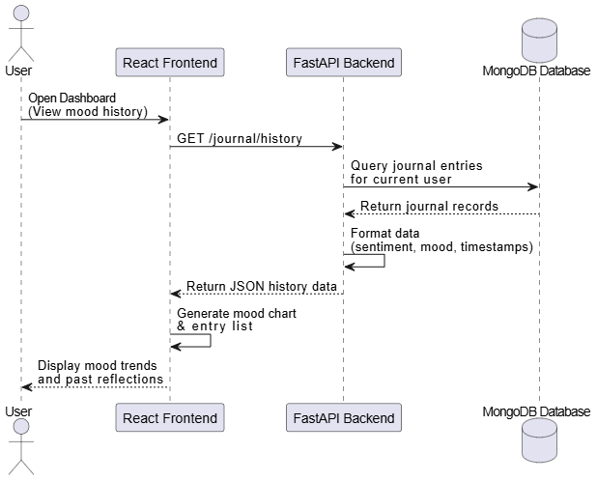
SEQUENCE DIAGRAM
-DASHBOARD
Team Nexus

Slide 22
SPRINT 1 RECAP
What We Set Out To Do
What We Delivered
We aimed to build a complete journaling experience where users can submit entries and have them processed through AI sentiment analysis. This included displaying sentiment results along with confidence scores, while ensuring a smooth user experience through proper input validation, submission confirmation, error handling, and automatic input reset. Additionally, we planned to allow users to view their previous journal entries (US13).
US1, US7, US10: Core Journal Functionality: Essential features that allow users to create, access, and manage their journal entries.
US2, US3, US4: Processing and AI Analysis: Journal Entry Processing, AI Sentiment Analysis and confidence score.
US5, US6, US8: Results and User Feedback: Sentiment Result Display, mood visualization and submission confirmation.
Team Nexus

Slide 23
PRODUCT BACKLOG
US11 – User Registration
As a user, I want to register an account so that my journal entries are securely stored.
Acceptance Criteria
Email & password required
Password hashed
User saved in database
Duplicate email prevented
US12 – User Login
As a user, I want to log in so that I can access my journal dashboard.
Acceptance Criteria
JWT token generated
Protected routes enforced
Login error handling
US13 – View Journal Entries
As a user, I want to view my previous journal entries so that I can reflect on past emotional states.
Acceptance Criteria
List view of entries
Emotion label shown
Sorted by date
Entries linked to user ID
Users access only their own data
CORE JOURNAL
FUNCTIONALITY
Priority: Must Story Points: 5
Priority: Must Story Points: 5
Priority: Must Story Points: 8
US6 – Mood Visualization
As a user, I want to see a simple visualization of my mood history so that I can begin identifying patterns.
Acceptance Criteria
Simple chart renders
Updates after submission
US16 – Error Handling
As a user, I want reliable error handling so that I understand when something goes wrong.
Acceptance Criteria
API errors handled gracefully
Clear error messages displayed
No system crashes
US18 – Improved Mood Visualization
As a user, I want a clearer visualization of my mood data so that I can better understand trends.
Acceptance Criteria
Chart labels are clear
Axes properly defined
Colors distinguish sentiment categories
RESULTS &
USER FEEDBACK
Priority: Should Story Points: 5
Priority: Must Story Points: 3
Priority: Should Story Points: 3
US15 – Store Sentiment Results
As a system, I want to store sentiment and confidence results so that they can be used for future analysis and visualization.
Acceptance Criteria
Sentiment label stored in database
Confidence score stored
Data retrievable for visualization and history
PROCESSING &
AI ANALYSIS
Priority: Should Story Points: 5
Detailed spreadsheet here

Slide 24
PRODUCT BACKLOG
US19 – Secure Backend Endpoints
As a system, I want to secure backend endpoints so that only authenticated users can access protected resources.
Acceptance Criteria
JWT required
Unauthorized requests blocked
Proper error responses
ADDITIONAL
FEATURES
Priority: Must Story Points: 3
US20 – Therapist Access
As a user, I want my therapist to have access to my journal and mood data.
US21 – Enable Sharing
As a user, I want to enable sharing of my journal data.
US22 – Disable Sharing
As a user, I want to disable sharing at any time.
FUTURE FEATURES
Priority: Could Story Points: 5
Priority: Could Story Points: 8
Priority: Could Story Points: 5
US23 – Therapist User List
As a therapist, I want to see my assigned users
US24 – Therapist Dashboard
As a therapist, I want to view journal entries and mood trends.
Priority: Could Story Points: 5
Priority: Could Story Points: 5
Detailed spreadsheet here

Slide 25
SPRINT 2 BACKLOG
Sprint Name: Sprint 2
Sprint Duration: April 3rd - April 16th
Sprint Length: 2 Weeks
Sprint Goal
Incorporate users into the system by implementing secure registration, login, and authenticated access to journal features.
Stories Committed
US6, US11, US12, US13, US15, US16, US17, US18, US19.
Total Story Points Committed: 40
Detailed spreadsheet here
Team Nexus

Slide 26
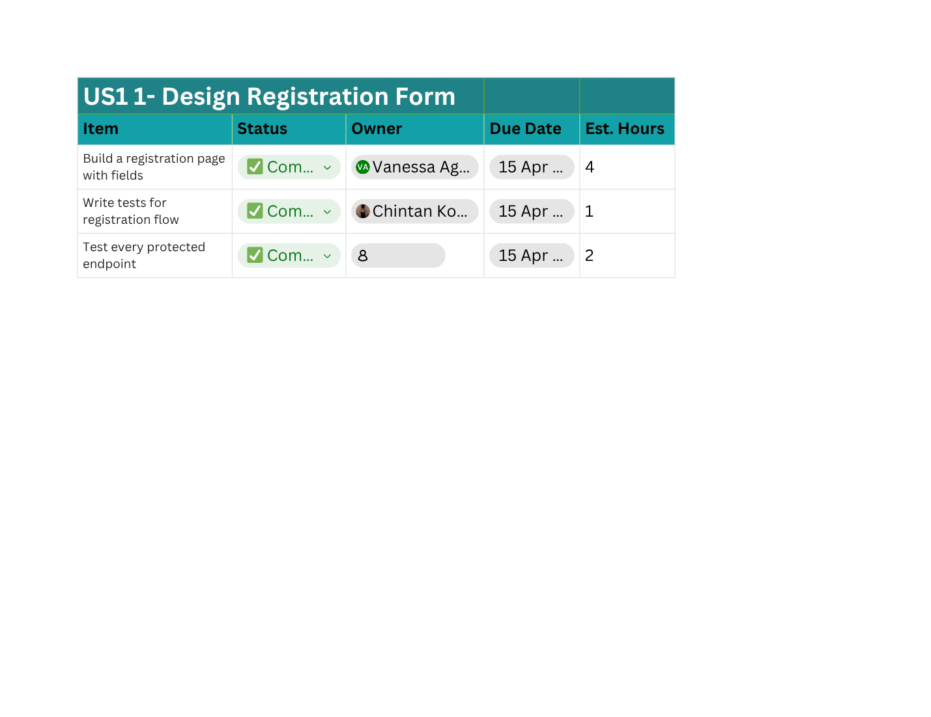
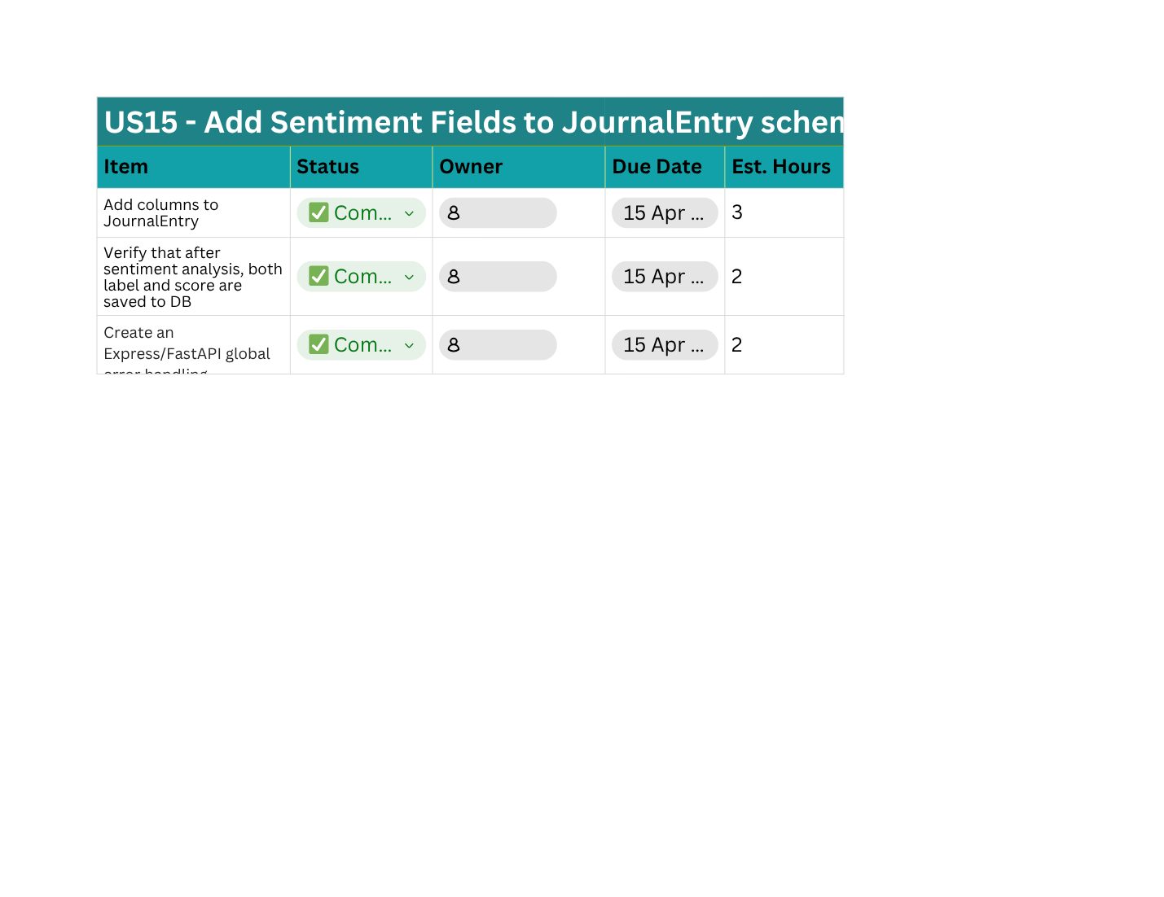
SPRINT 2 TASK BREAKDOWN
During Sprint 2, user stories were decomposed into technical tasks to distribute work among team members and track implementation progress.
Task breakdown allows the team to:
Assign clear responsibilities
Estimate development effort
Track sprint progress
Enable parallel development
Detailed spreadsheet here
Team Nexus

Slide 27
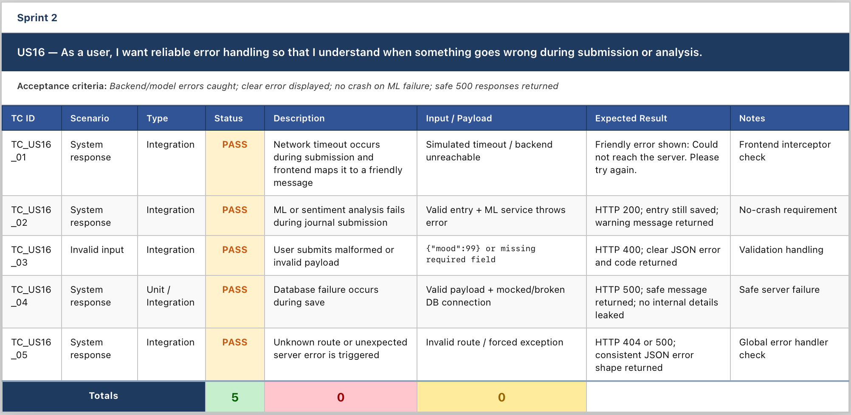
SPRINT 2 TEST CASE
Detailed spreadsheet here

Slide 28
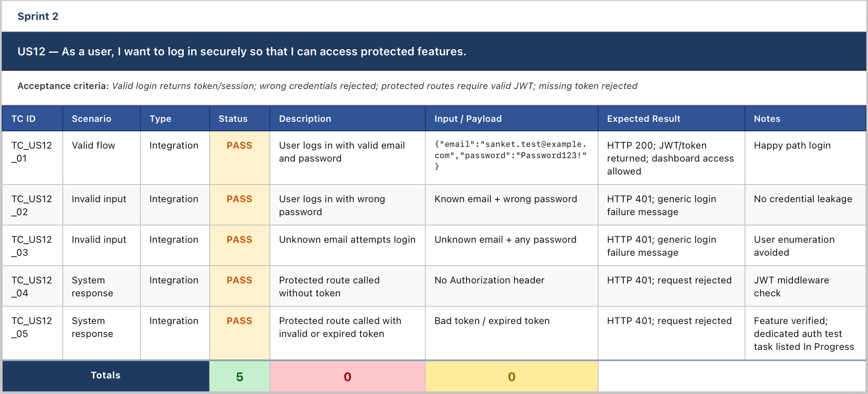
SPRINT 2 TEST CASE
Detailed spreadsheet here

Slide 29
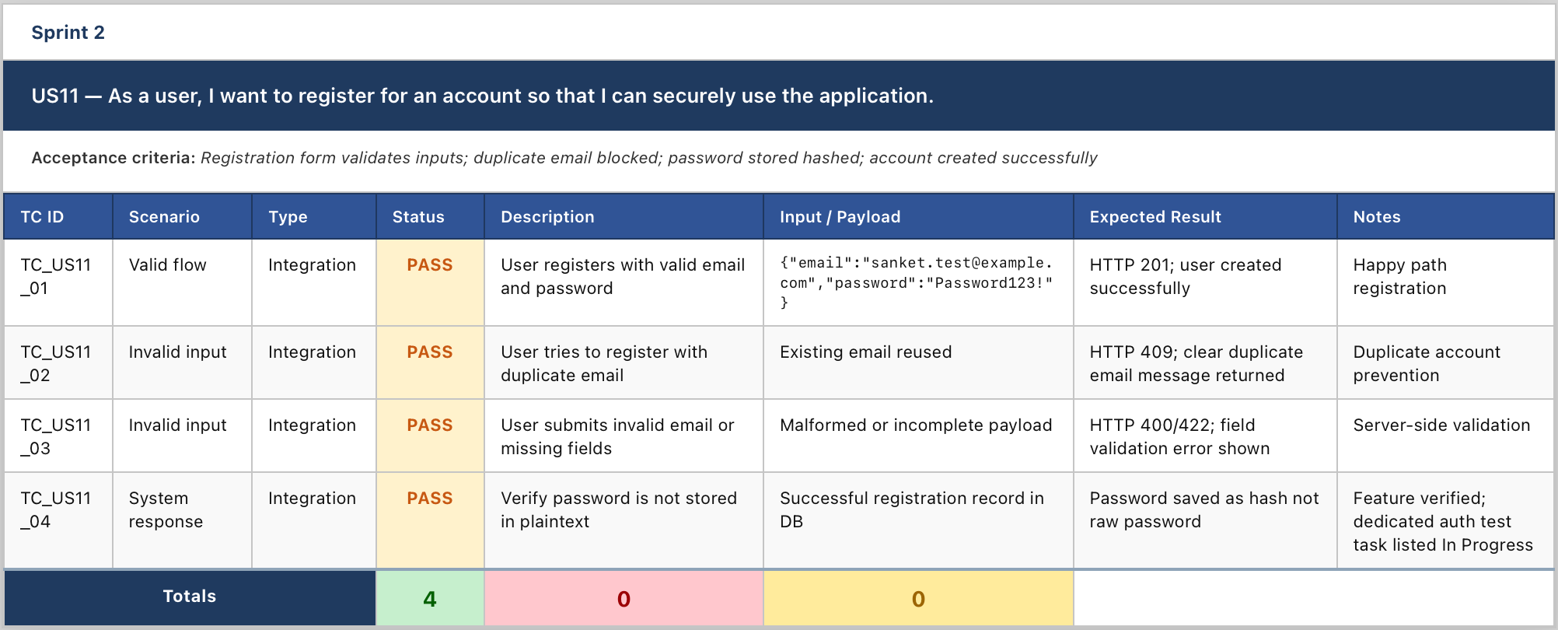
SPRINT 2 TEST CASE
Detailed spreadsheet here

Slide 30
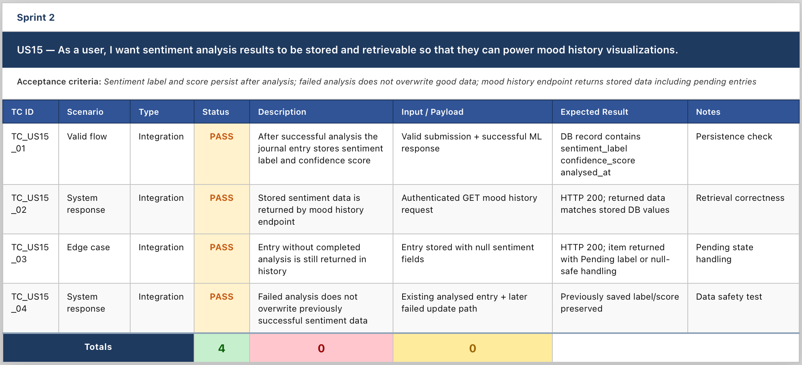
SPRINT 2 TEST CASE
Detailed spreadsheet here

Slide 31
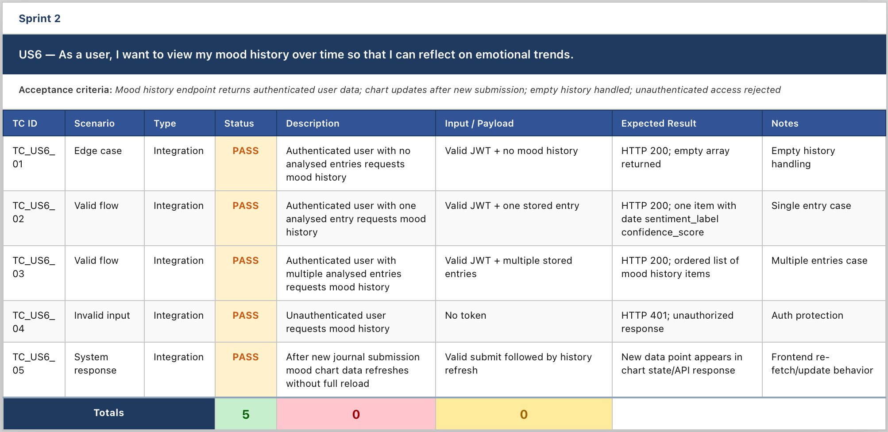
SPRINT 2 TEST CASE
Detailed spreadsheet here

Slide 32
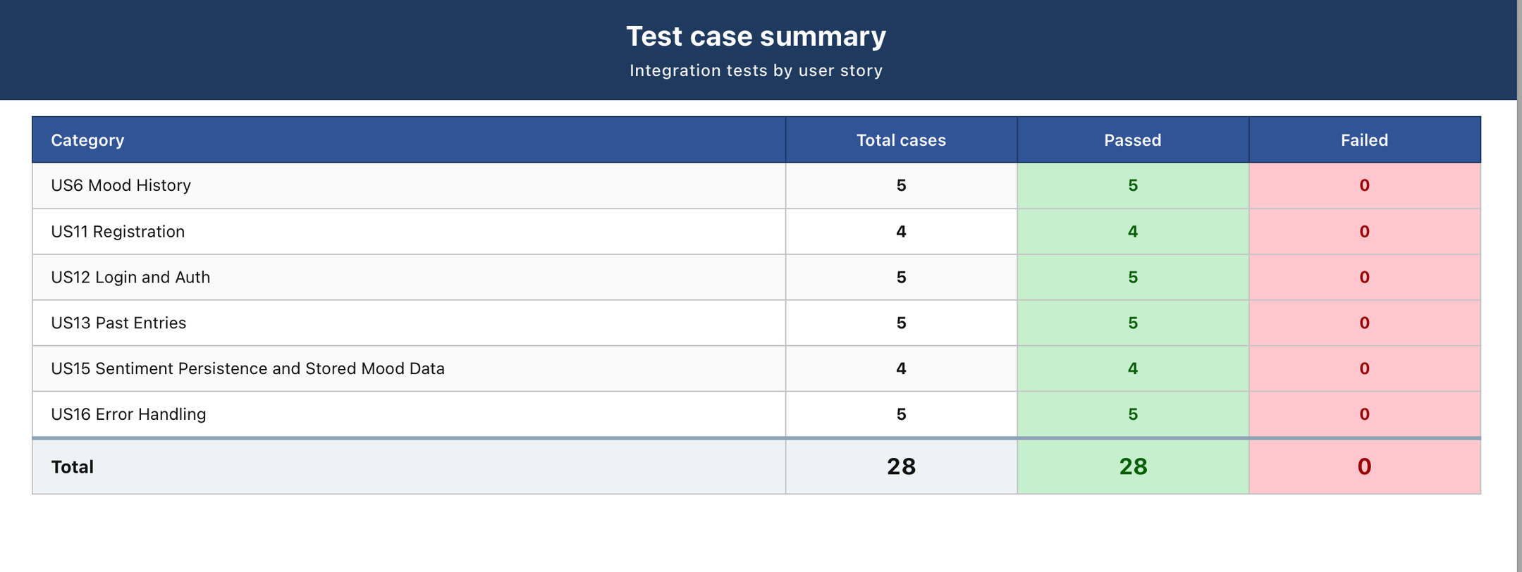
SPRINT 2 TEST CASE SUMMARY

Slide 33

SPRINT 2 STORIES COMPLETED
US6 - Mood History Visualization
US11 - User Registration
US12 - User Login
US13 - View Past Journal Entries
US15 - Store Sentiment Results
US16 - Error Handling
US17 - Loading Indicator
US18 - Improved Mood Visualization
US19 - Authentication SecuritY
Detailed spreadsheet here
Team Nexus

Slide 34
SPRINT 2 STORIES NOT COMPLETED
These stories will be carried over to Sprint 3 for completion:
US20 – Therapist Access
US21 – Enable Sharing
US22 – Disable Sharing
US23 – Therapist User List
US24 – Therapist Dashboard
Detailed spreadsheet here
Team Nexus

Slide 35
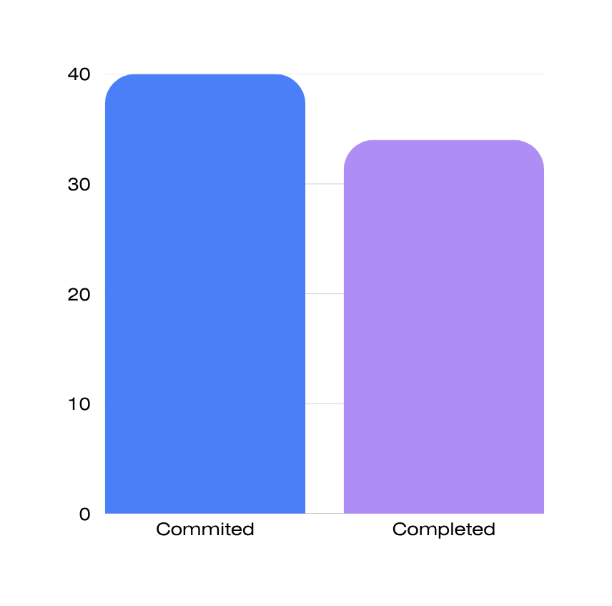
METRICS
Team Velocity
Team estimated points | 40
Team points delivered | 34
Total points carried over | 6
Team Velocity | 34
Team Nexus

Slide 36
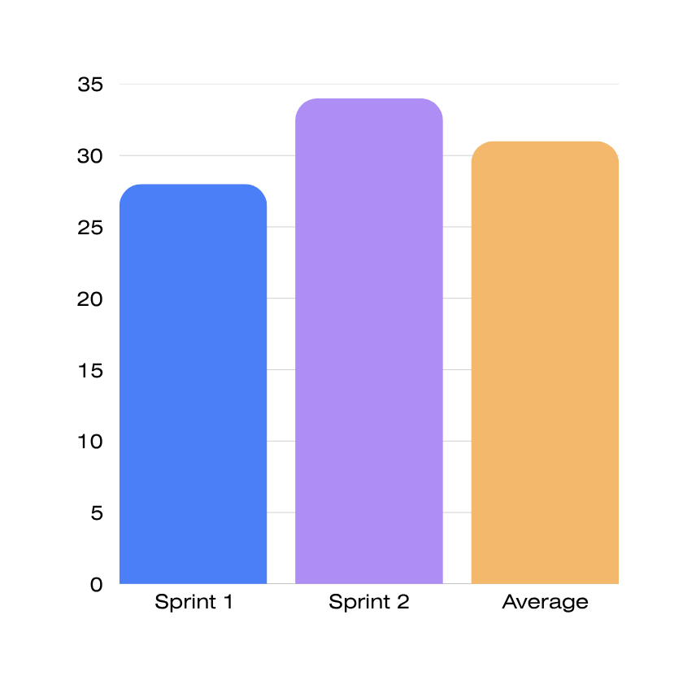
METRICS
Team Velocity
Total velocity of sprint 1: 28
Total velocity of sprint 2: 34
Average: 31
Team Nexus

Slide 37
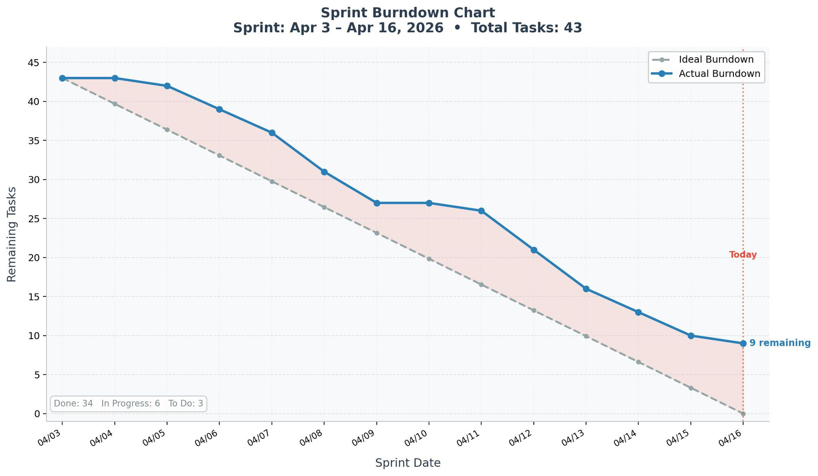
BURNDOWN STATUS
Team Nexus

Slide 38
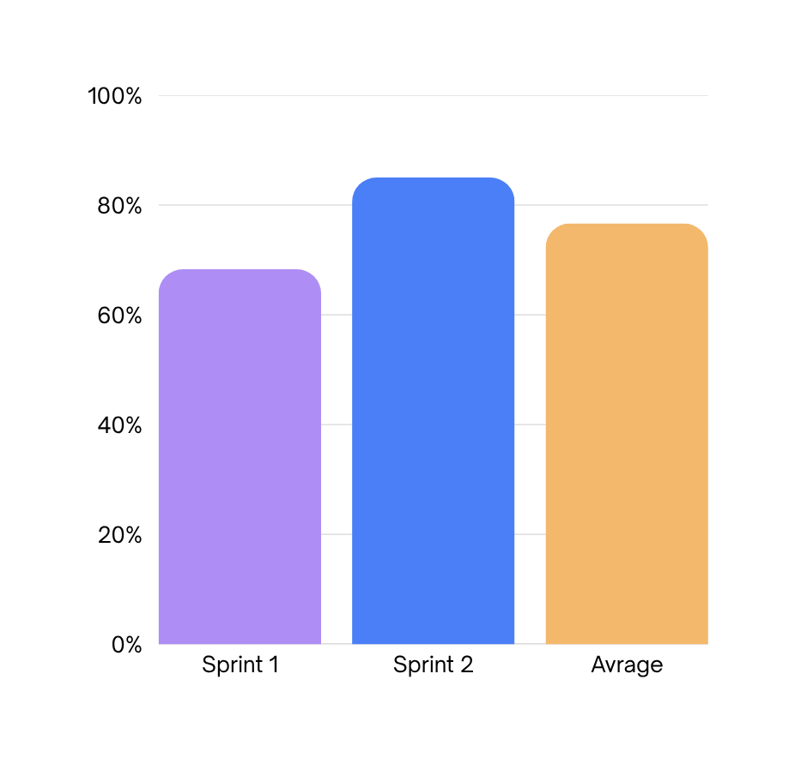
COMPLETED VS COMMITTED
Sprint 1:
Committed: 41
Completed: 28
Ratio: 68.29%
Sprint 2:
Committed: 40
Completed: 36
Ratio: 85%
Average: 76.65%
Team Nexus

Slide 39
RETROSPECTIVE
WHAT WENT WELL
WHAT COULD BE IMPROVED?
ACTIONS FOR NEXT SPRINT
Daily stand-ups are more structured
and focused on blockers and progress
Earlier start on documentation and
slides
Begin documentation alongside
development
Better collaboration between co-owners
on shared tasks
Communication could be more consi-
stent across the team
Increase activity on communication
platform
Team members supported each other
when blocked
Improve sprint planning accuracy
Improve estimation during sprint
planning
Team Nexus

Slide 40
WIKI PAGE LINK

Slide 41
DEMO

Slide 42
THANK YOU
17 April, 2026

